Slide 1

Coupled electron-nuclear dynamics
- Mitul Akbari
- Prof. Dr. Daria Gorelova
22/01/2024 (08:30) Computational physics with focus on time-dependent quantum mechanics

Slide 2
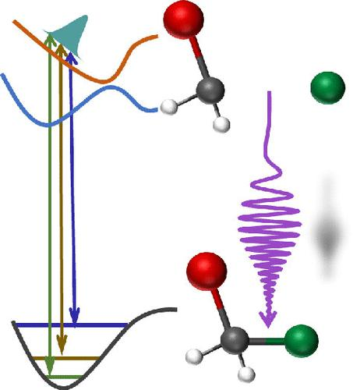
Coupled electron-nuclear dynamics
The study of coupling between electronic and nuclear motions, as this interaction is fundamental to the understanding of molecular processes.
Photo induced processes directly affects electronic stucture and gives rise to dynamics between electron and nucleus.
Some of the proccesses involving such dynamics are photodissociation, light energy conversion, light harvesting.

Slide 3
Coupled electron-nuclear dynamics
What happens during a photodissociation process when light pulse hits a molecule?
Befor light hits the molecule, it has bound states where individual atoms(ions) are bound in the molecular geometry.
These bound states exists in some potential(different for different molecular geometries) are which is then modified due to the influence of external potential introduced by the light field.

Slide 4
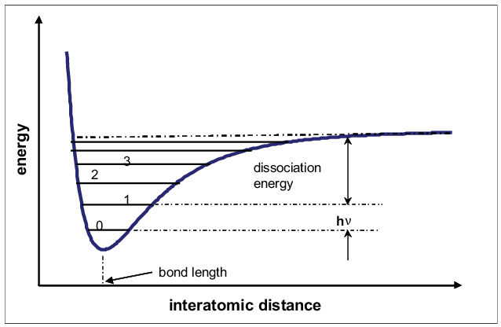
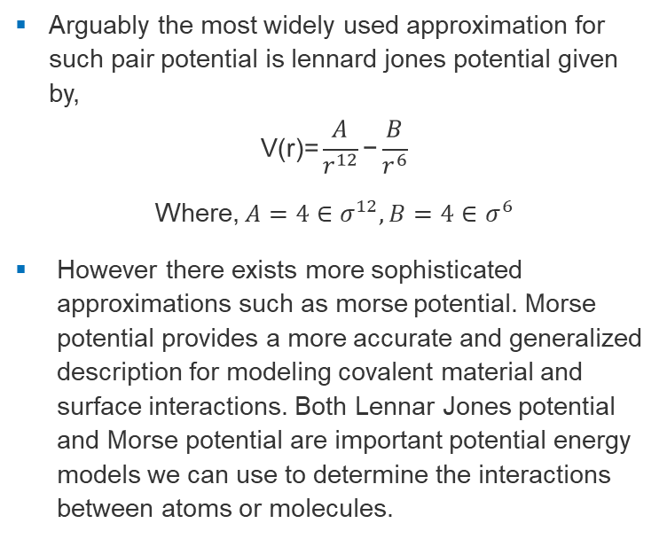
Coupled electron-nuclear dynamics
Arguably the most widely used approximation for such pair potential is lennard jones potential given by,
$$\text{V}\text{(}\text{r}\text{)=}\frac{A}{r^{12}}\text{−}\frac{B}{r^{6}}$$
Where, $A=4∈σ^{12},B=4∈σ^{6}$
However there exists more sophisticated approximations such as morse potential. Morse potential provides a more accurate and generalized description for modeling covalent material and surface interactions. Both Lennar Jones potential and Morse potential are important potential energy models we can use to determine the interactions between atoms or molecules.

Slide 5
Coupled electron-nuclear dynamics
To keep things simple harmonic oscillator potential has been used in this simulation.
Solutions of ground state harmonic oscillator potential are well known Hermite-Gaussian functions.

Slide 6
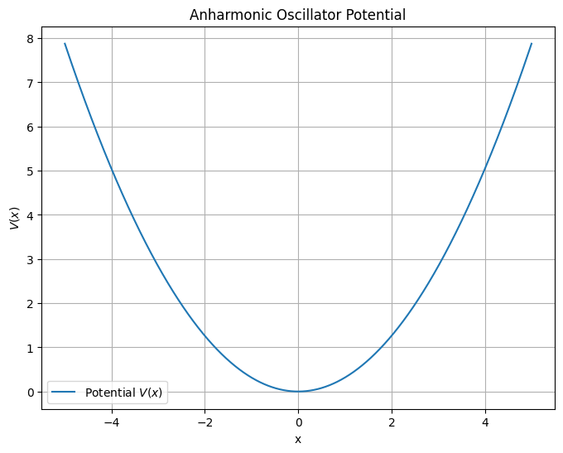
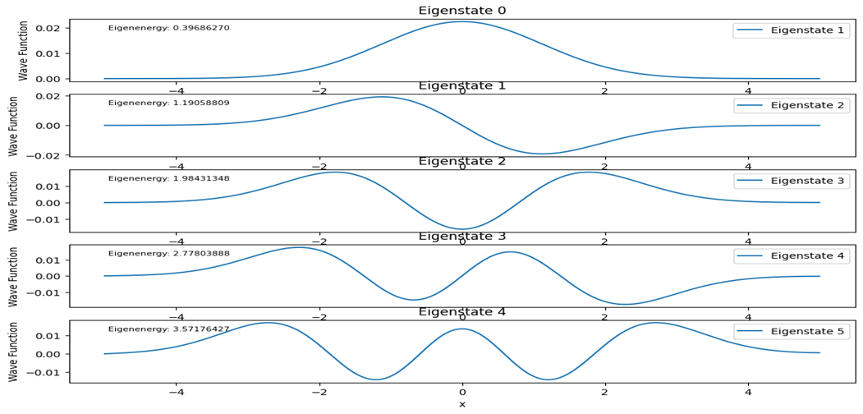
Coupled electron-nuclear dynamics

Slide 7
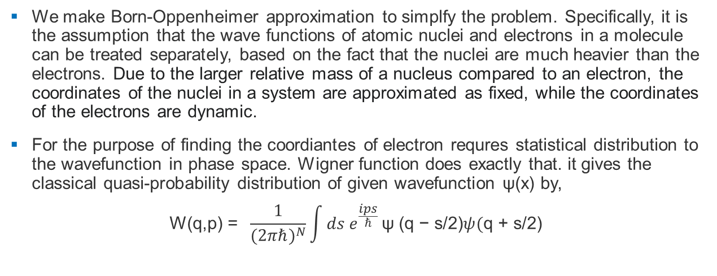
Coupled electron-nuclear dynamics
We make Born-Oppenheimer approximation to simplfy the problem. Specifically, it is the assumption that the wave functions of atomic nuclei and electrons in a molecule can be treated separately, based on the fact that the nuclei are much heavier than the electrons. Due to the larger relative mass of a nucleus compared to an electron, the coordinates of the nuclei in a system are approximated as fixed, while the coordinates of the electrons are dynamic.
For the purpose of finding the coordiantes of electron requres statistical distribution to the wavefunction in phase space. Wigner function does exactly that. it gives the classical quasi-probability distribution of given wavefunction $\text{ψ}$(x) by,
$$\text{W}\text{(}\text{q}\text{,}\text{p}\text{)} \text{=} \frac{1}{{(2πℏ)}^{N}}\int{ds e^{\frac{ips}{ℏ}}}\text{ψ} \text{(}\text{q}\text{ − }\text{s}\text{/2}\text{)}ψ(\text{q}\text{ + }\text{s}\text{/2}\text{)}$$

Slide 8
Coupled electron-nuclear dynamics
From hereon following parameters have been used to generate initial wavefunction for harmonic oscillator potential,
parameter | Value(in atomic units)
C(spring_constant) | 1500
m | 2000
x | (-2, 2)Angsrom
x0 | 0
s0 | 0

Slide 9
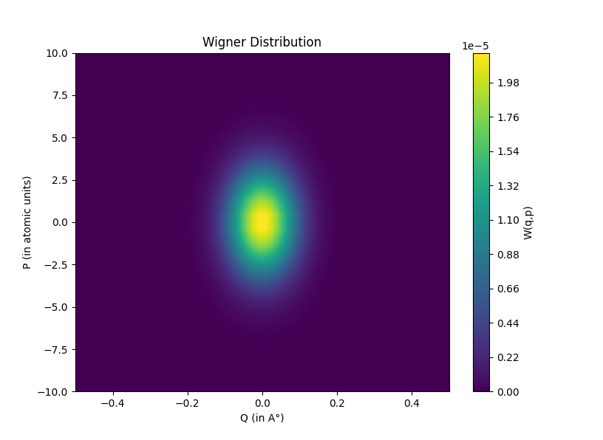
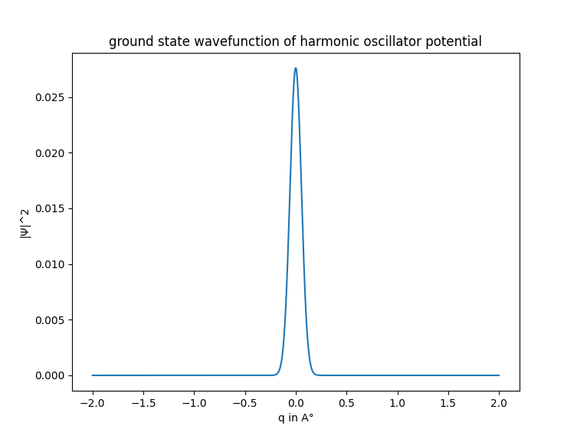
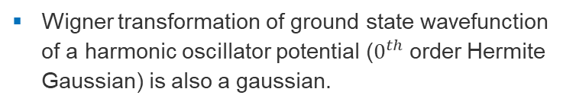
Coupled electron-nuclear dynamics
Let us now consider ground state wavefunction
Wigner transformation of ground state wavefunction of a harmonic oscillator potential ($0^{th}$order Hermite Gaussian) is also a gaussian.

Slide 10
Coupled electron-nuclear dynamics
Sampling the Wigner distribution function
there are two general approaches for sampling the Wigner distribution for the molecule’s vibrational state specified by the molecule’s quantum numbers. For one, the total energy is not fixed and the Wigner distribution for each mode is sampled independently.
For the second, an ensemble with a fixed total energy is sampled, properly weighted by the Wigner distribution for all N modes. Either sampling approach may be used for a simulation of a molecule in a specific quantum state n.
Here, we will use both these methods.

Slide 11
Coupled electron-nuclear dynamics
The procedure for sampling the trajectory initial coordinates and momenta in this manner is as follows. [Fixed energy sampling using orthant sampling]
Find the total energy for N normal modes.
Select a random point on the energy shell using a 2N-dimensional random unit vector.
The selected phase space point is then used to evaluate the Wigner distribution function.
von Neumann’s rejection method61 is then employed in accepting or rejecting the point, i.e., accept the point if W/W0 > Ri , where W0 is the most probable value of W and Ri is a fresh random number which is between 0 and 1, otherwise go to step 2 and do all over again.

Slide 12
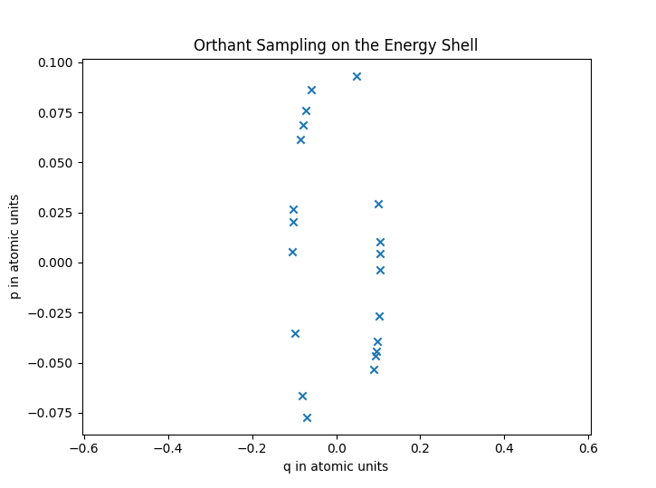
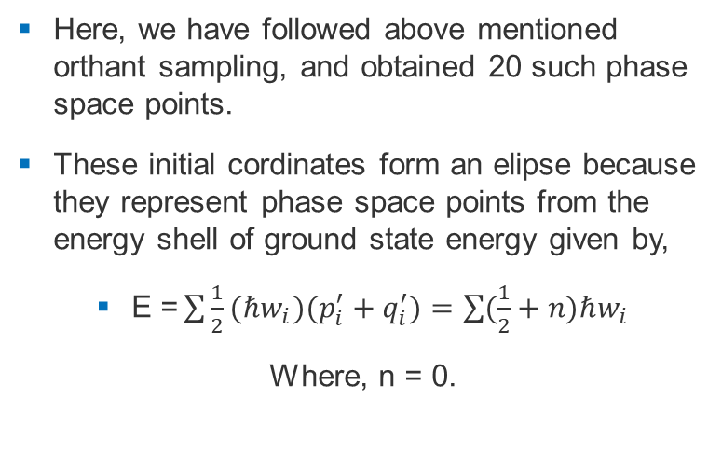
Coupled electron-nuclear dynamics
Here, we have followed above mentioned orthant sampling, and obtained 20 such phase space points.
These initial cordinates form an elipse because they represent phase space points from the energy shell of ground state energy given by,
$\text{E}\text{ =}\sum{\frac{1}{2}(ℏw_{i})(p_{i}^{′}+q_{i}^{′})}=\sum{(\frac{1}{2}+n)ℏw_{i}}$
Where, n = 0.
Now, it is possible to propogate these phase space coordinated in presence of some potential that we are interested in.

Slide 13
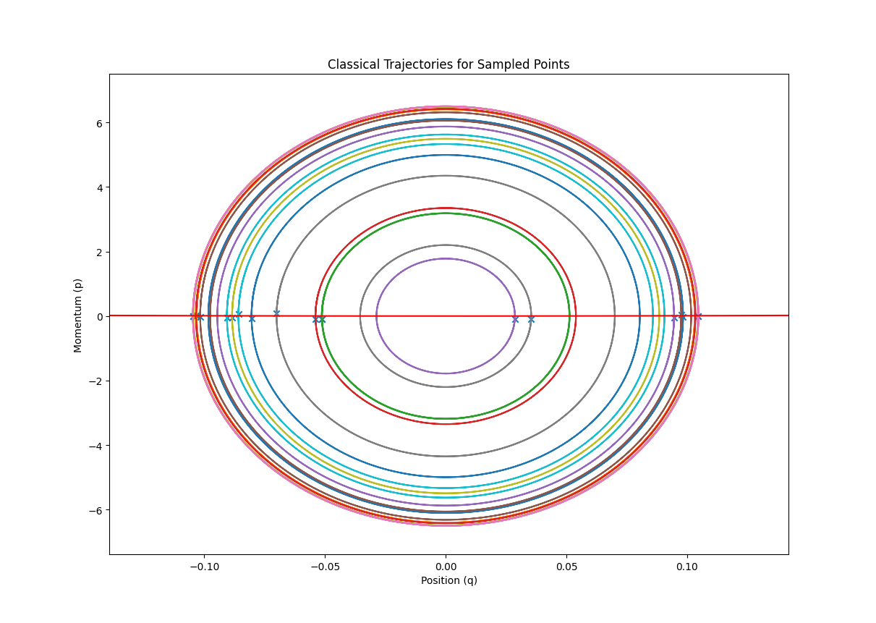
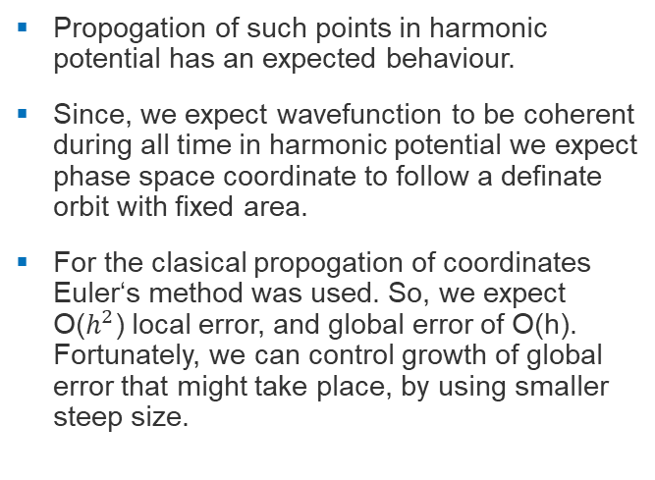
Coupled electron-nuclear dynamics
Propogation of such points in harmonic potential has an expected behaviour.
Since, we expect wavefunction to be coherent during all time in harmonic potential we expect phase space coordinate to follow a definate orbit with fixed area.
For the clasical propogation of coordinates Euler‘s method was used. So, we expect O($h^{2}$) local error, and global error of O(h). Fortunately, we can control growth of global error that might take place, by using smaller steep size.

Slide 14
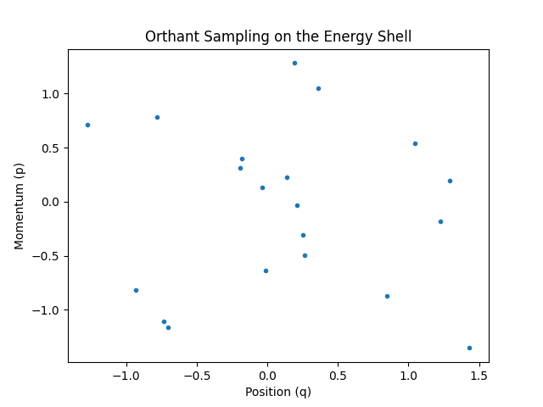
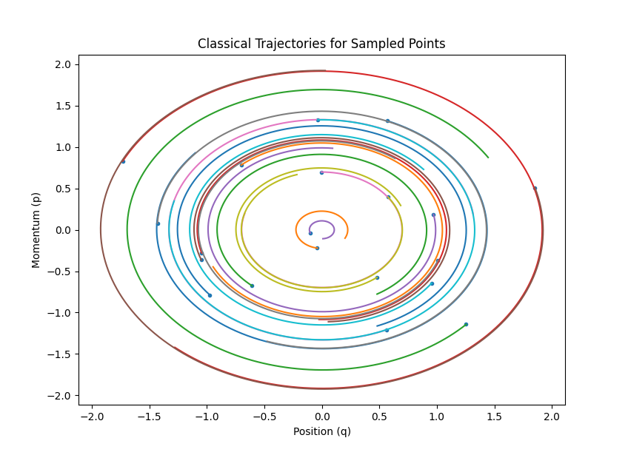
Coupled electron-nuclear dynamics
Here are sample pints and its propagation with the total energy not fixed and the Wigner distribution for each mode is sampled independently.

Slide 15
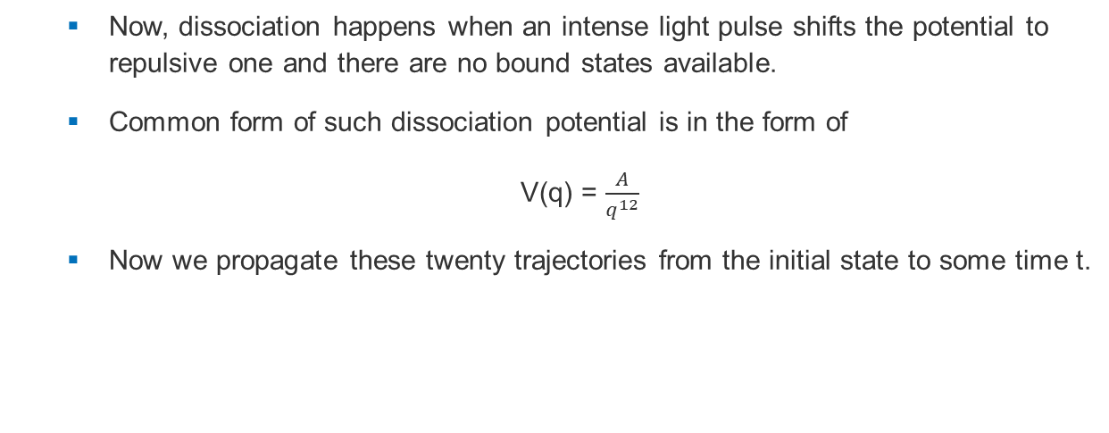
Coupled electron-nuclear dynamics
Now, dissociation happens when an intense light pulse shifts the potential to repulsive one and there are no bound states available.
Common form of such dissociation potential is in the form of
V(q) = $\frac{A}{q^{12}}$
Now we propagate these twenty trajectories from the initial state to some time t.

Slide 16
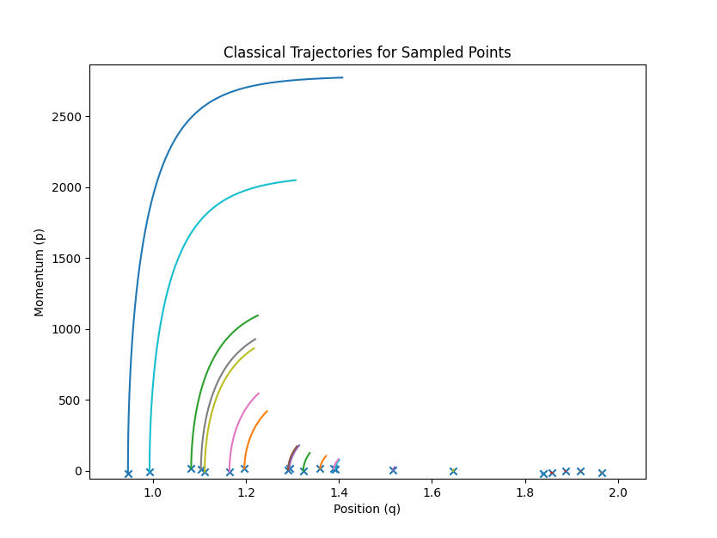
Coupled electron-nuclear dynamics
Here, we see that points that are closer (near the wavefunction centre) gains most momentum from the disassosiation potentual suggesting a spread of the wavefunction.(for 0.01fs)

Slide 17
Coupled electron-nuclear dynamics
By studying classical propagation of phase space coordiantes we can simulate chemical reactions by elucidating the intricate interplay between electrons and nuclei during bond formation, cleavage, and rearrangement in a computationally efficient manner. This understanding is crucial for designing and optimizing chemical reactions.
Enables the investigation of ultrafast processes and phenomena, shedding light on timescales that were previously challenging to explore. This is particularly relevant in fields like femtochemistry, where reactions occur on extremely short timescales.

Slide 18
Coupled electron-nuclear dynamics
Bibliography:
Classical Treatment of Nuclear Motion - Chemistry LibreTexts (chapter 16.3).
Comparisons of classical and Wigner sampling of transition state energy levels for quasiclassical trajectory chemical dynamics simulations
Mathematical Devices for Optical Sciences (Sibel Bas¸kal, Young S Kim, and Marilyn E Noz)(Chapter:5)
Electron-nuclear entanglement in the time-dependent molecular wavefunction Federica Agostinia , E.K.U. Grossb,c , Basile F.E. Curchod
WS22 database, Wigner Sampling and geometry interpolation for confgurationally diverse molecular Datasets. Max Pinheiro Jr, ShuangZhang, PavloO. Dral & Mario Barbatti

